Slide 1
Lecture 16
Threads Introduction
National University of
Computer & Emerging Sciences

Slide 2
Example: Designing Web server
Web server accepts client requests for
  Web pages
  Images
  Sound, etc
It may have thousands of clients accessing it concurrently.
How would you design it?

Slide 3
Designing Web server
A web server process
How you are going to handle client requests?
  Is it possible with a single process?
  No.
  One process per request?
  No.
Notes:
How would single process handle concurrently? It can only handle one request at a time. Other would have to wait in a queue.
If we talk about one process per requests, means if we create new process each time a request arrives. Even then it is going to be very expensive.

Slide 4
Designing Web server
Process creation
  Time consuming, resource intensive
If a new process performs same task then why create a new one?
Solution:
  Use threads
  Reuse process resources

Slide 5
What is a process?
A computer program in execution on a machine is a process
More formally:
  A Sequential stream of Execution in its own address space

Slide 6
Why use processes?
Why use processes?
  Express concurrency
  Systems have many concurrent jobs going on
  E.g. Multiple users running multiple shells, I/O, ...

Slide 7
Why use processes?
A process has an
  Executable program
  Stack, Registers
  Open files
  Child processes information
  Accounting information
  Signal handlers,…

Slide 8
Process Characteristics
Concept of Process has two aspects.
A Process is:
  A Unit of resource ownership:
    a virtual address space for the process image
    control of some resources (files, I/O devices...)
  A Unit of execution - process is an execution path through one or more programs
    may be interleaved with other processes
    execution state (Ready, Running, Blocked...) and dispatching priority

Slide 9
Process Characteristics
These two characteristics are treated separately by some recent operating systems:
  The unit of resource ownership is usually referred to as a process or task
  The unit of execution is usually referred to a thread or a “lightweight process”

Slide 10
Threads
Processes are used to group resources together
Threads are the entities scheduled for execution on the CPU
Threads are also called lightweight process
We can have multiple threads in a single process, this is called multithreading.

Slide 11
Its better to distinguish between the two concepts
  Address space/Global Variables
  Open files
  Child processes
  Accounting info
  Signal handlers
  Program counter
  Registers
  Stack
  State
Heavy weight process
In case of multiple threads per process
Unit of Resource
Split
Unit of Execution/Dispatch
  Program counter
  Registers
  Stack
  State
Light weight processes
  Address space/Global Variables
  Open files
  Child processes
  Accounting info
  Signal handlers
  Program counter
  Registers
  Stack
  State
  Program counter
  Registers
  Stack
  State
Share

Slide 12

Single and Multithreaded Processes

Slide 13

Process Vs. Threads
(a) Three threads, each running in a separate address space
(b) Three threads, sharing the same address space

Slide 14
Threads
Allow multiple execution paths in the same process environment
Threads share address space, open files etc
But have own set of Program counter, Stack etc
The first thread starts execution with int main(int argc, char *argv[])
The threads appear to the Scheduling part of an OS just like any other process

Slide 15
Unit of Dispatching
Path of execution
  Program counter: which instruction is running
  Registers:
    holds current working variables
  Stack:
    Contains the execution history, with one entry for each procedure called but not yet returned
  State

Slide 16

The Thread Model
Each thread has its own stack

Slide 17
Thread Usage
Less time to create a new thread than a process
    the newly created thread uses the current process address space
    no resources attached to them
Less time to terminate a thread than a process.
Less time to switch between two threads within the same process, because the newly created thread uses the current process address space.
Less communication overheads
    threads share everything: address space, in particular. So, data produced by one thread is immediately available to all the other threads
Performance gain
    Substantial Computing and Substantial Input/Output
Useful on systems with multiple processors

Slide 18
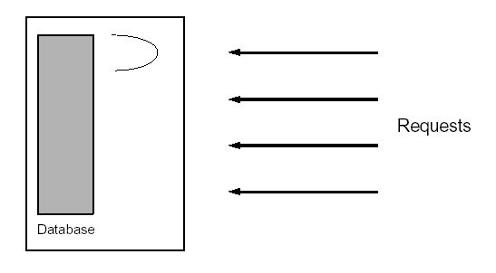
1. Single threaded database server
Handles multiple clients
  Either handle the requests sequentially
  Or multiplex explicitly by creating multiple processes
Problem with 1
  Unfair for quick requests, occurring behind lengthy requests
Problem with 2
  Complex and error prone
  Heavy IPC required

Slide 19
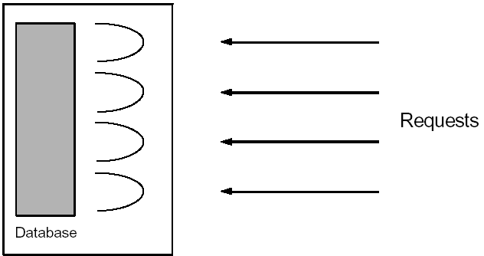
1. Multithreaded database server
Assign a separate thread to each request
As fair as in the multiplexed approach.
The code is as simple as in the sequential approach, since the address space is shared => all variables are available
Some synchronization of access to the database is required, this is not terribly complicated.

Slide 20

e.g. A multithreaded web server

Slide 21
When to use threads?
If a program can be organized into discrete, independent tasks which can execute concurrently

